Slide 1
Updates on RestorationMapper
Progress since December

Slide 2
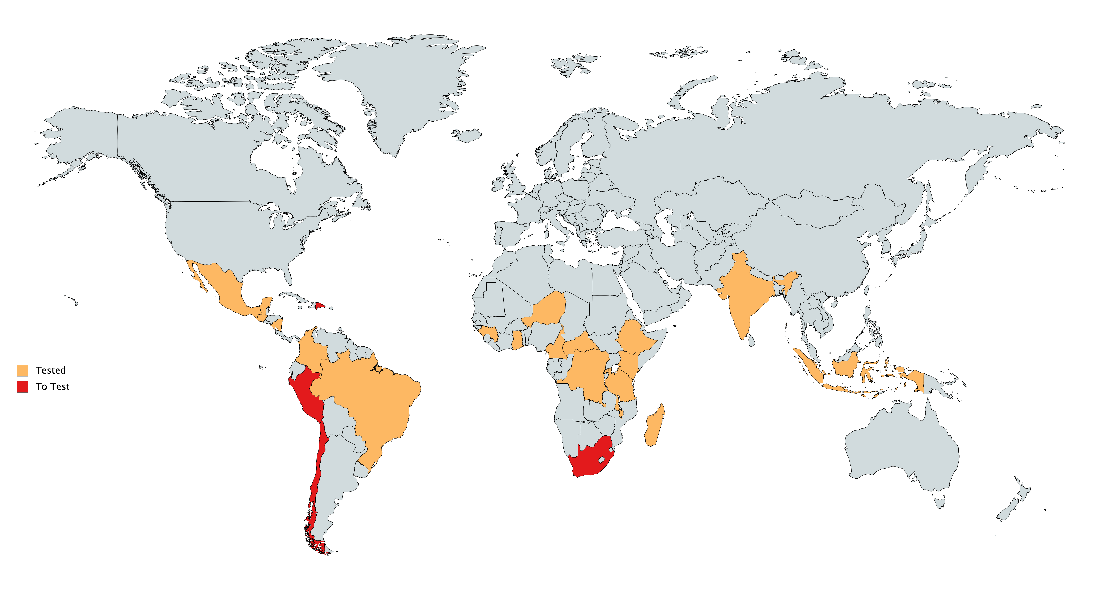
Tested Countries

Slide 3
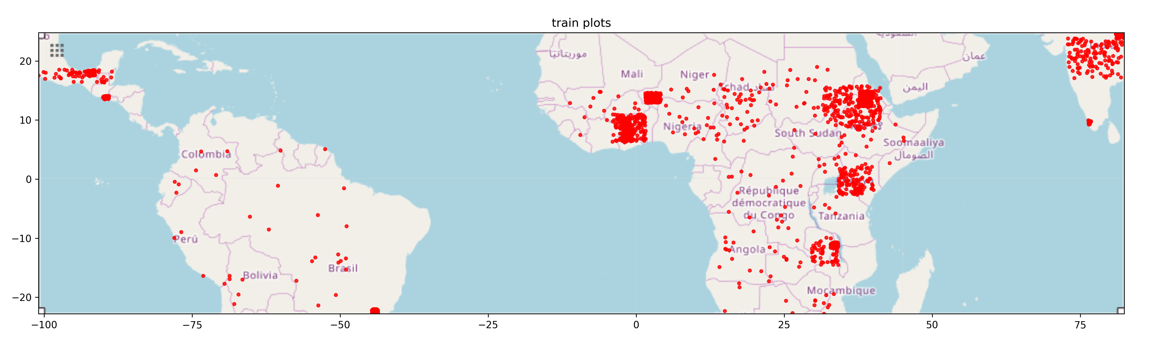
Source Data
700 -> 2700 plots

Slide 4
Data and computational efficiency
5x reduction in data storage space (from 625 gb/1 Mha to 140), and complete migration of data I/O to the cloud

Slide 5
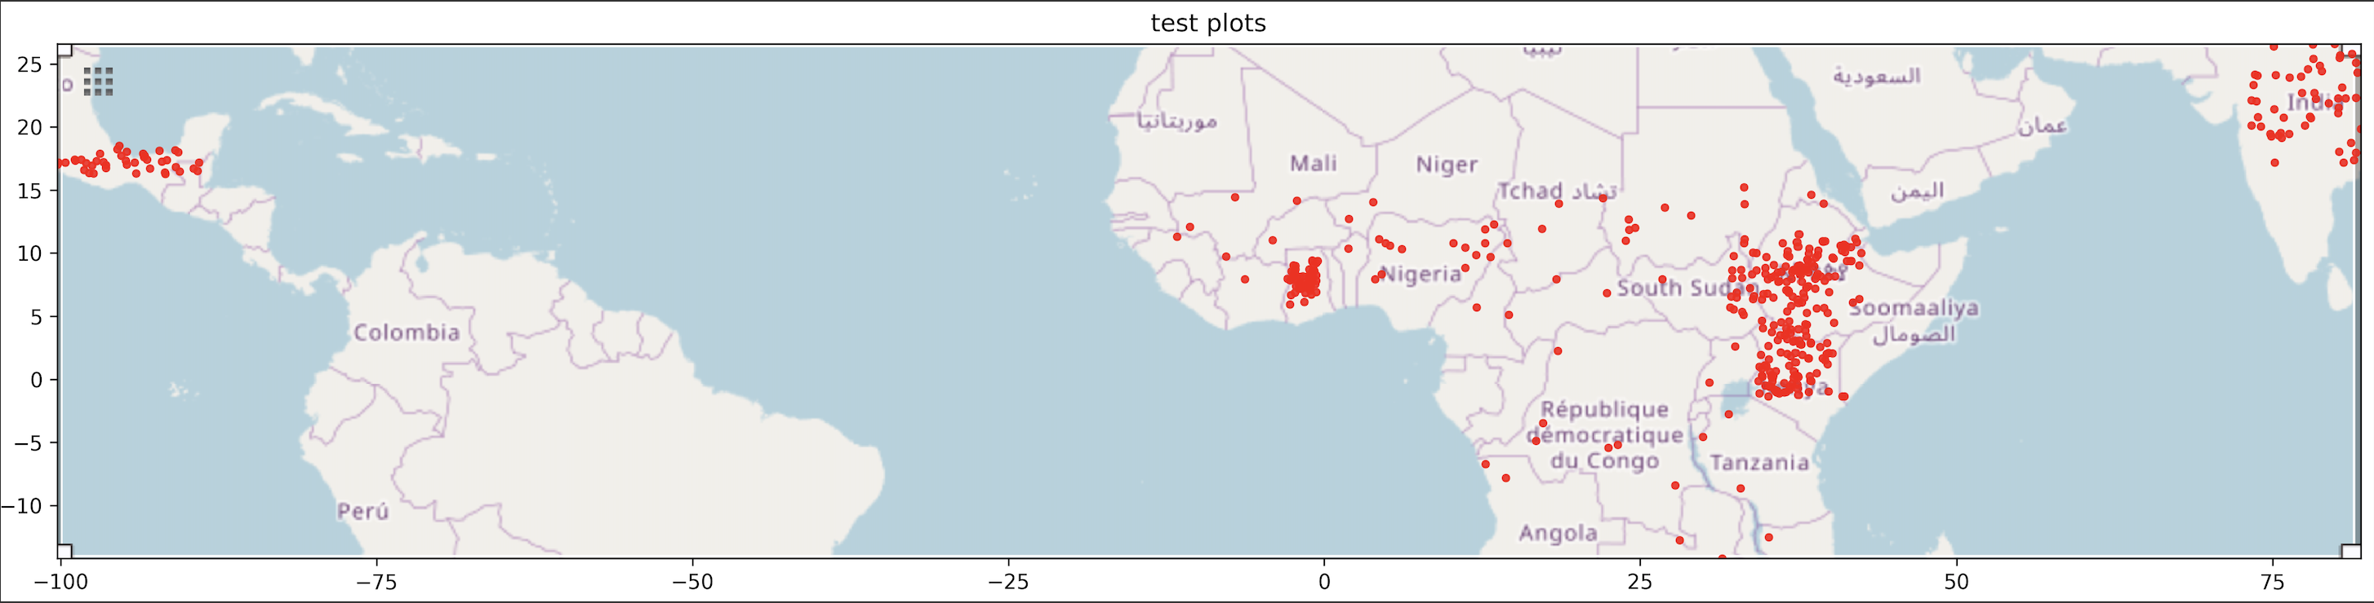
Accuracy (Mean of users + producers)
Overall: 79% -> 84% -> 87%
Latin America: ?% -> 90%
East Africa: 79% -> 85%
West Africa: ?% -> 83%
India: ?% - > 80%

Slide 6
Next steps
Radar (sentinel 1)
Data downloaded and fused
Investigating effect on performance this week
Continent / region performance metrics
Parameter tuning
Cloud optimization
East Africa, West Africa, South America, LAC, India/Asia
~100 USD / 1 Million hectares

Slide 7
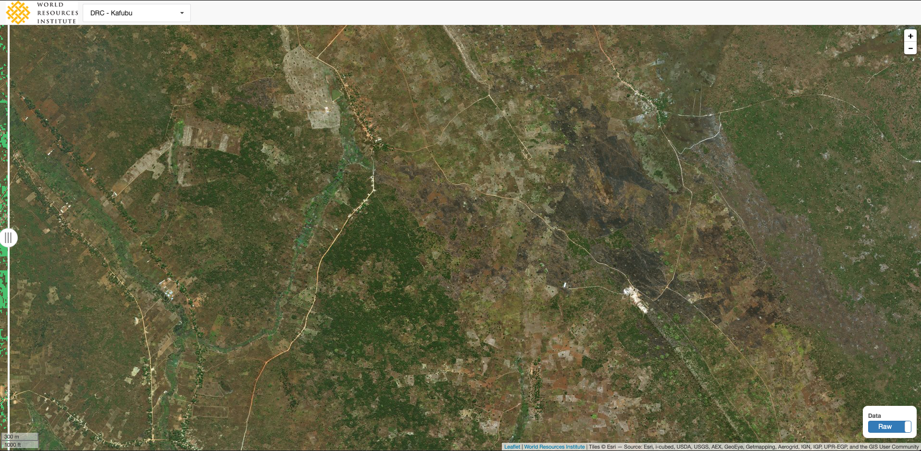
DRC

Slide 8
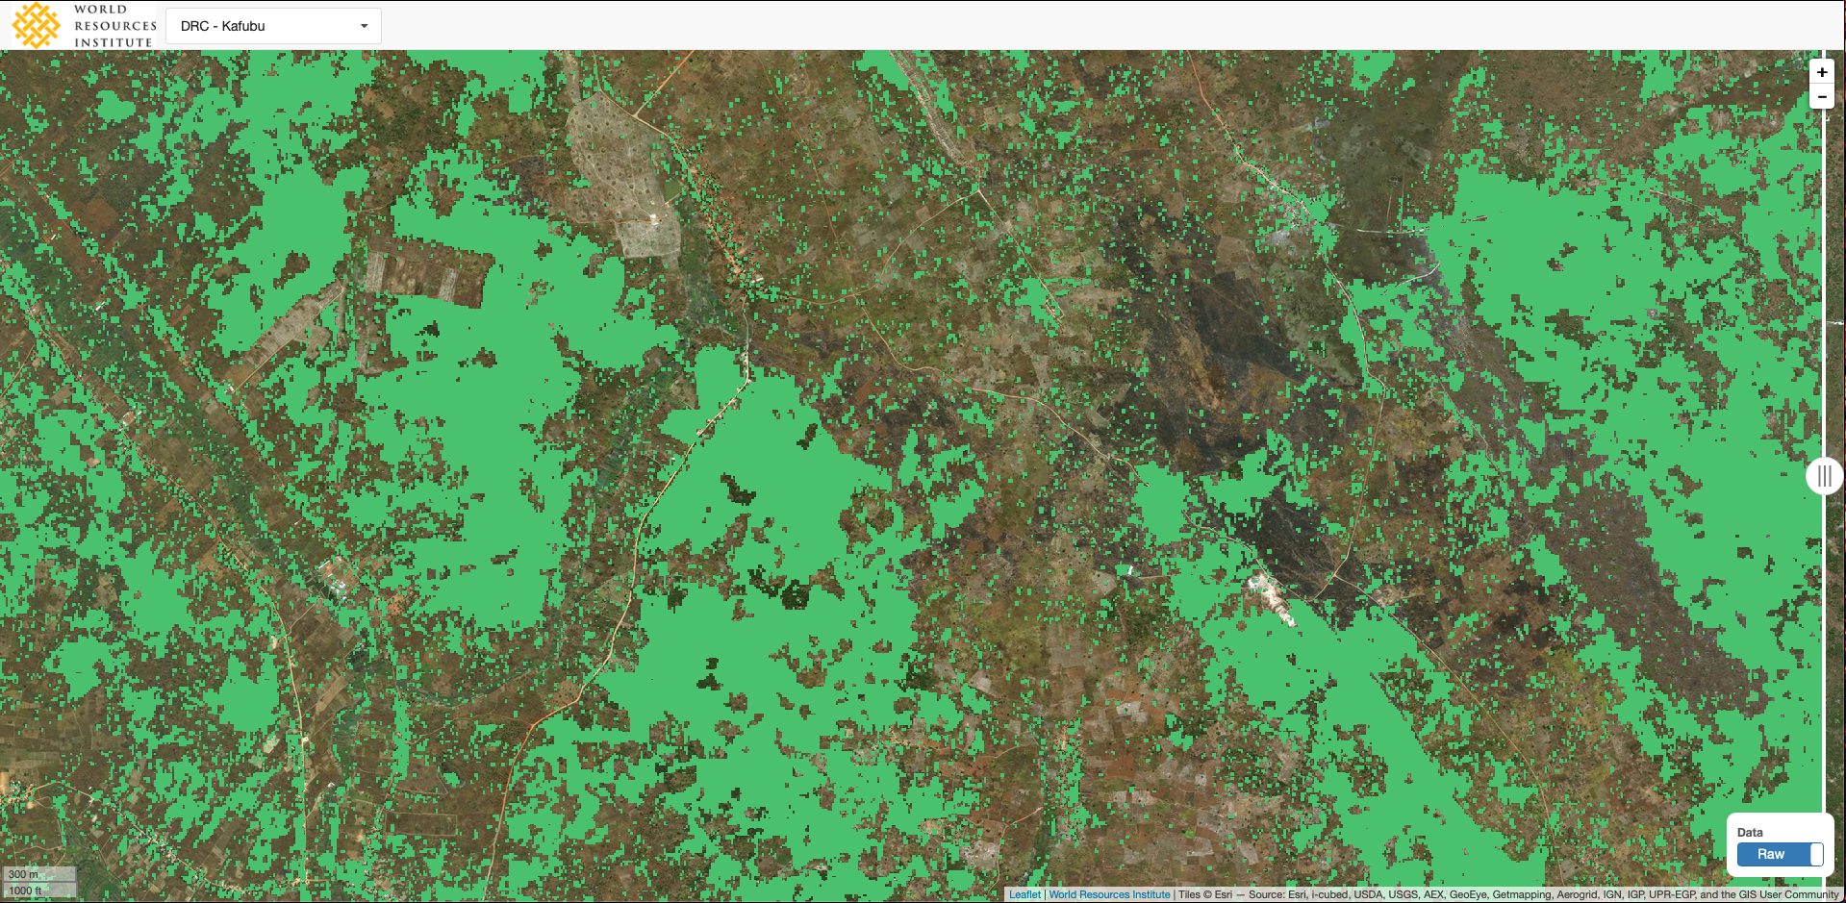

Slide 9
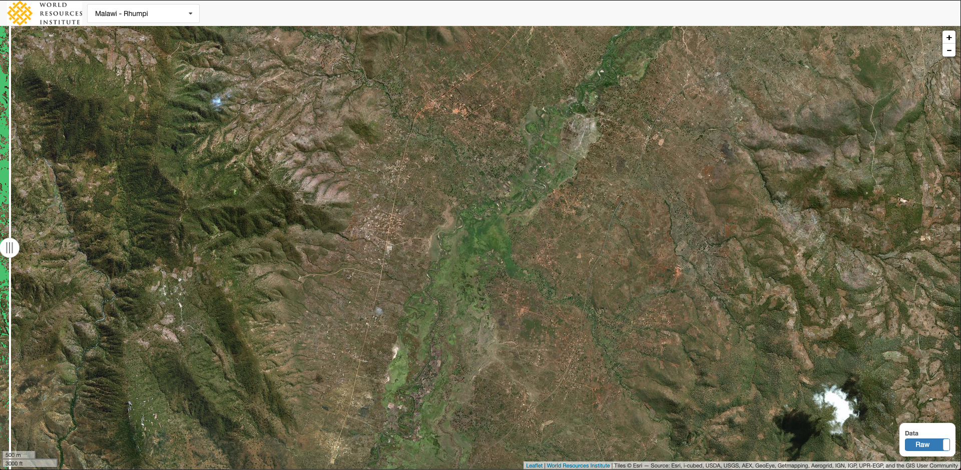
Malawi

Slide 10
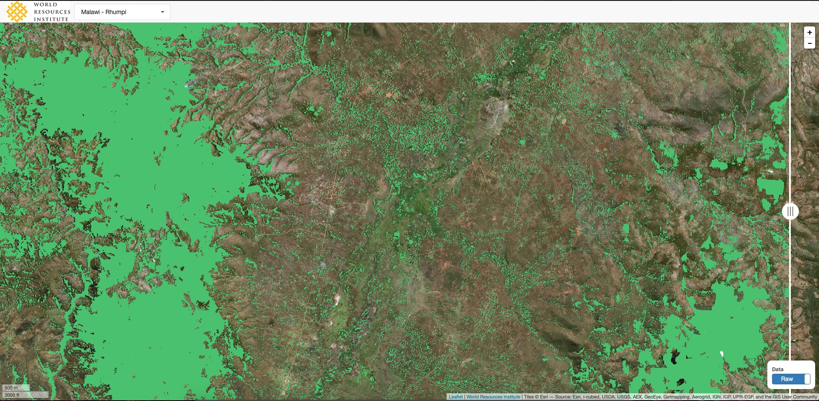
MALAWI

Slide 11
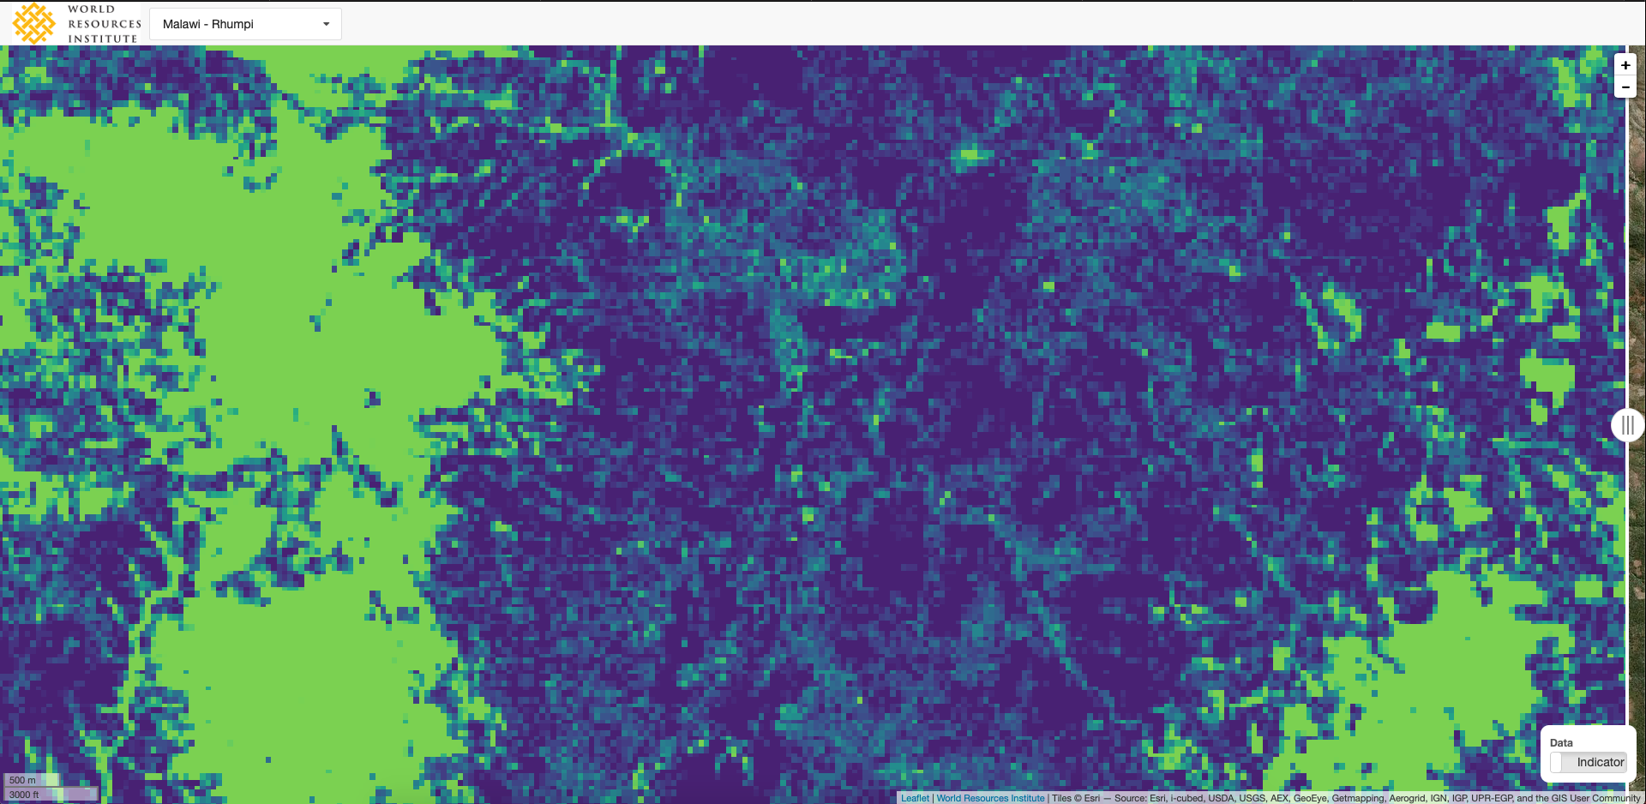
MALAWI

Slide 12
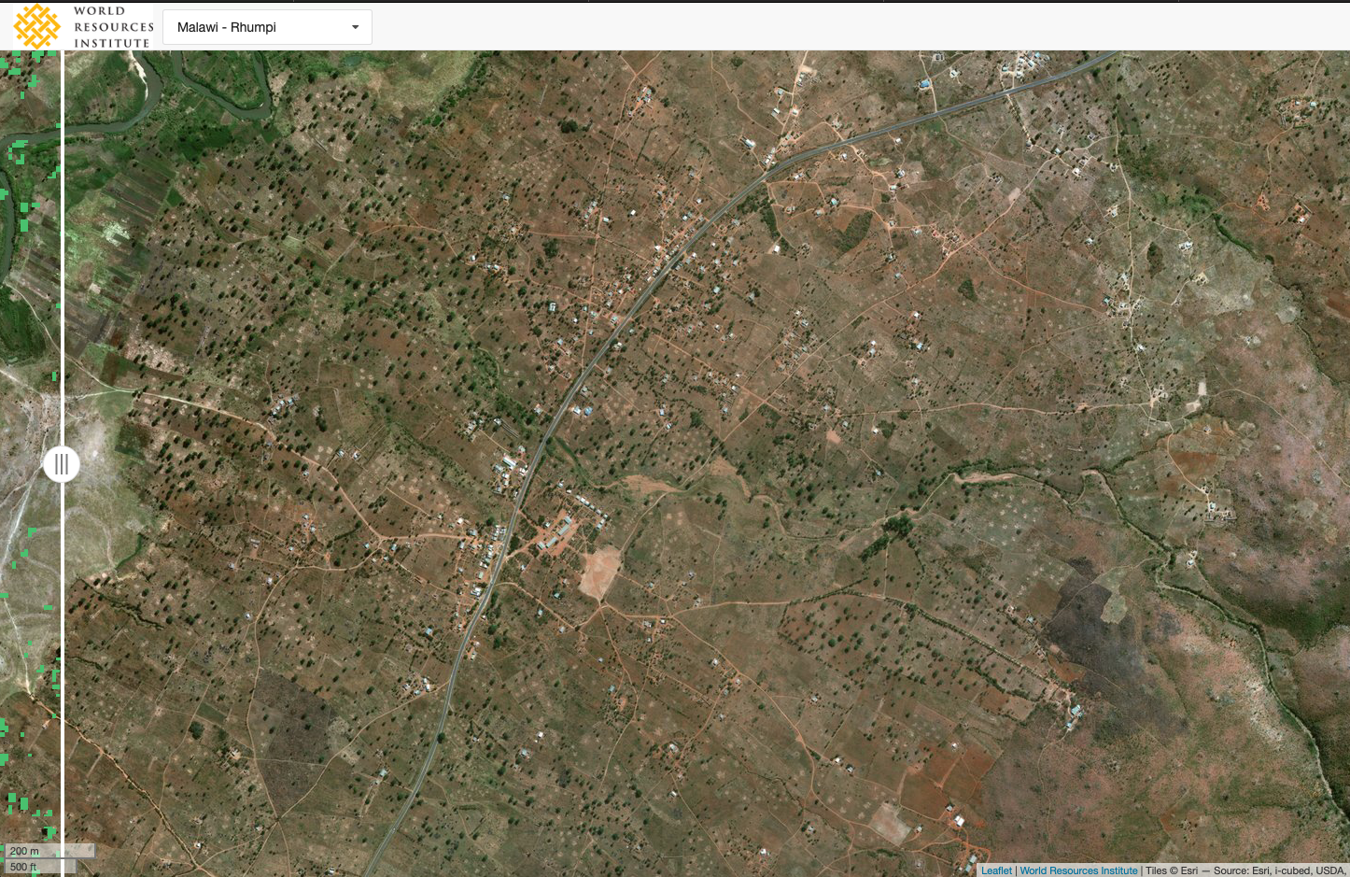
MALAWI

Slide 13
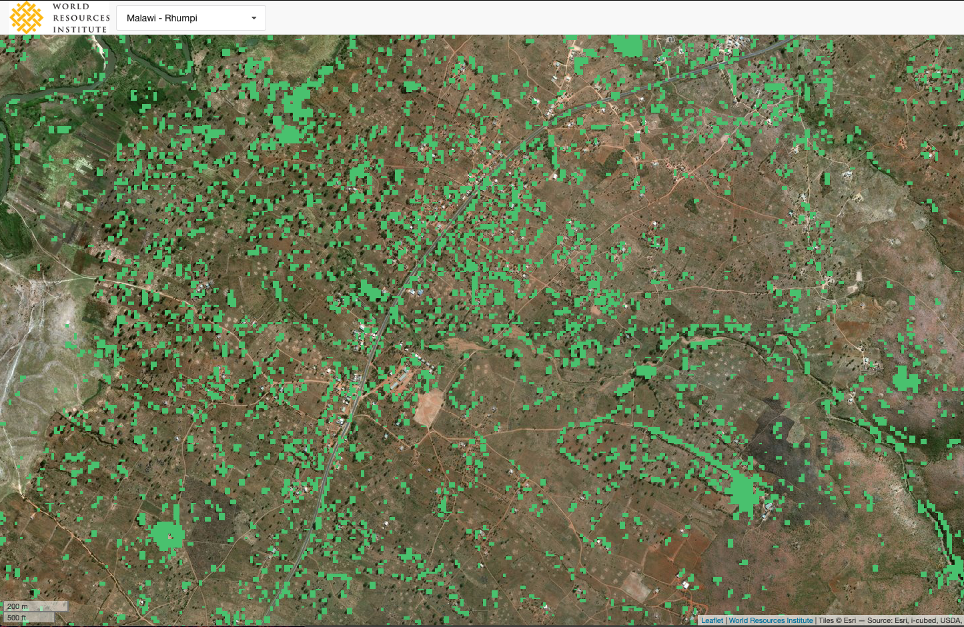
MALAWI

Slide 14
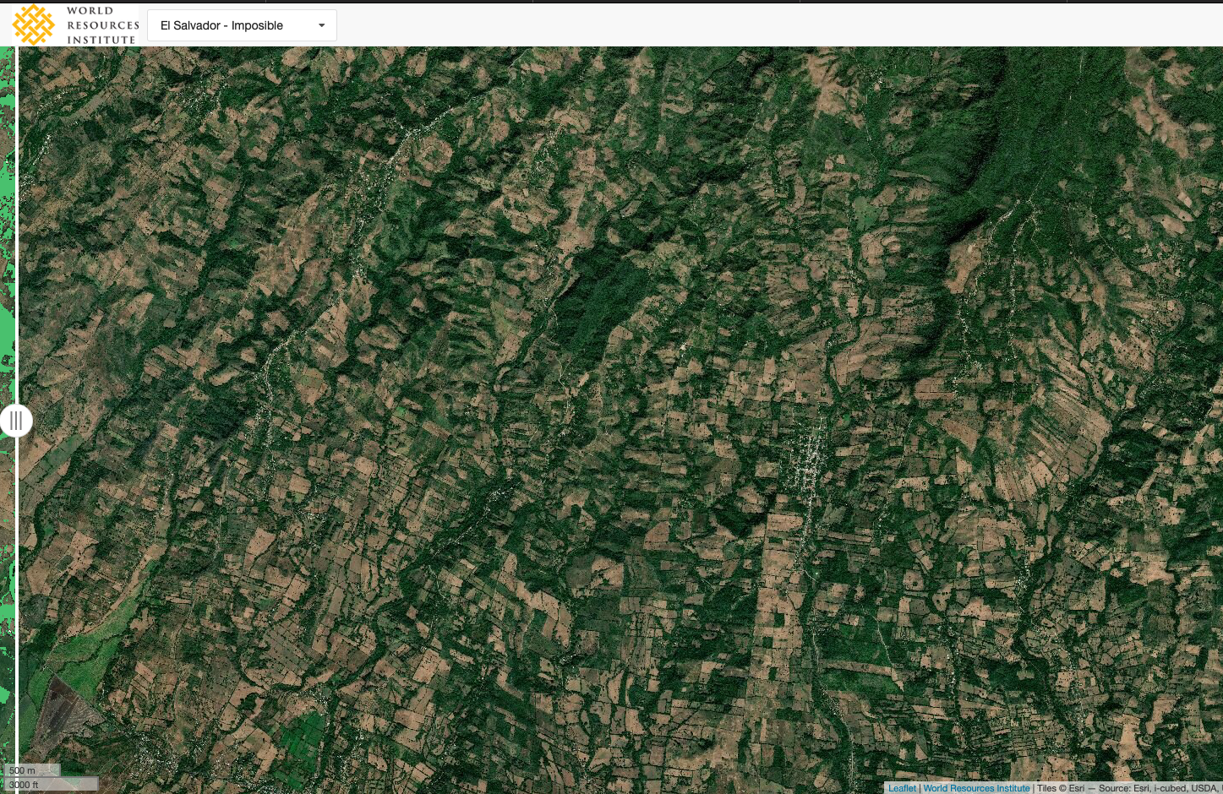
El SALVADOR

Slide 15
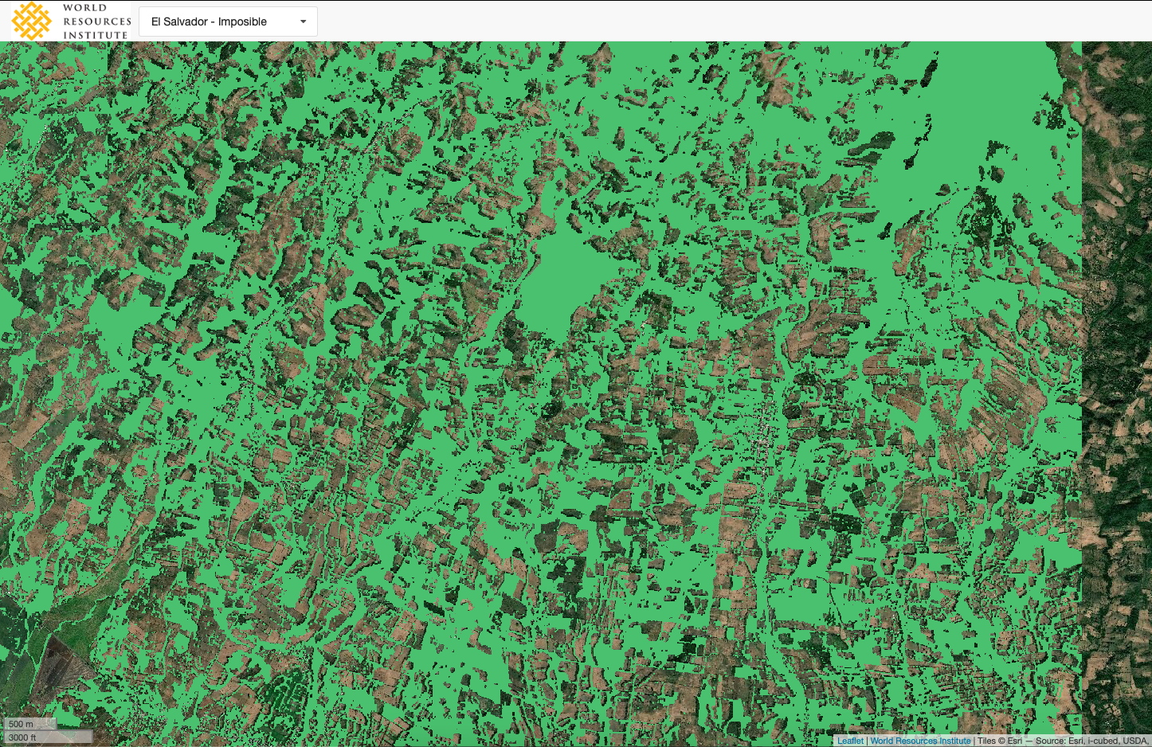
EL SALVADOR

Slide 16
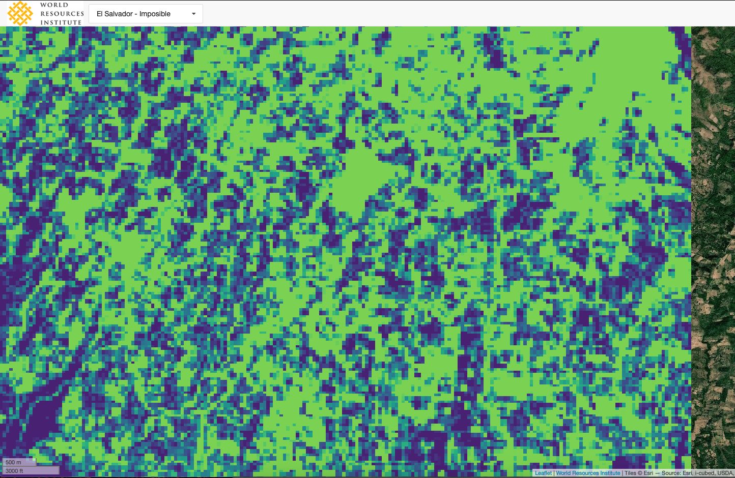
El SALVADOR

Slide 17
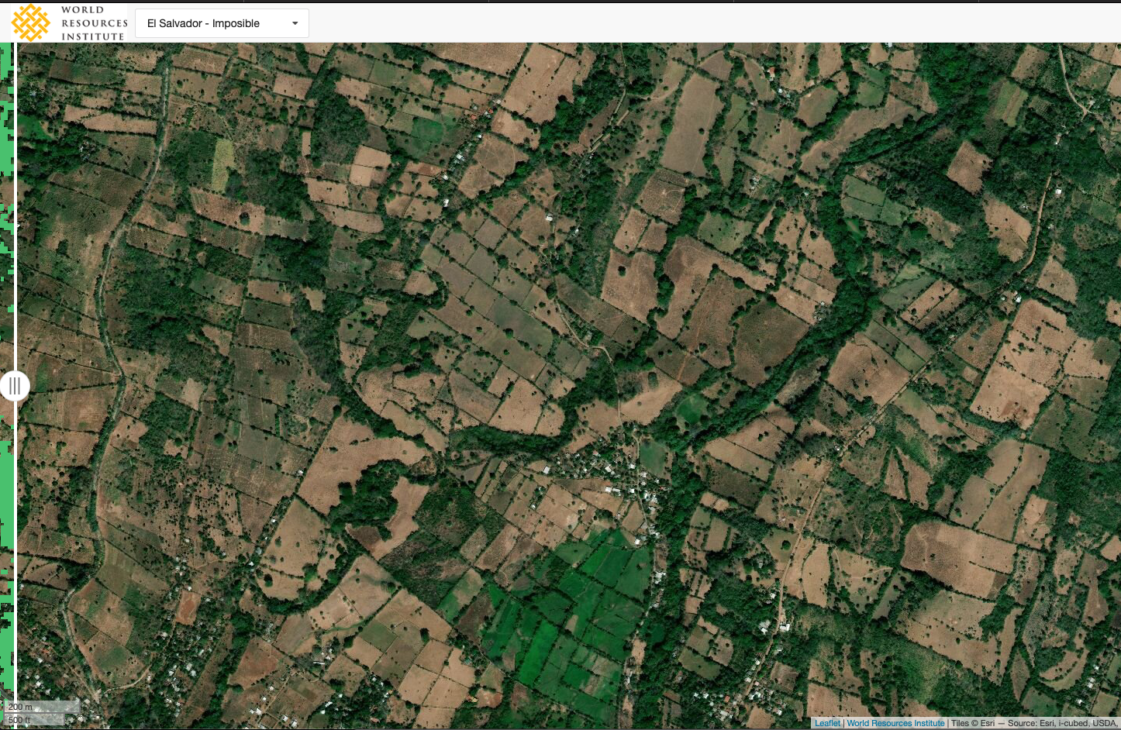
EL SALVADOR

Slide 18
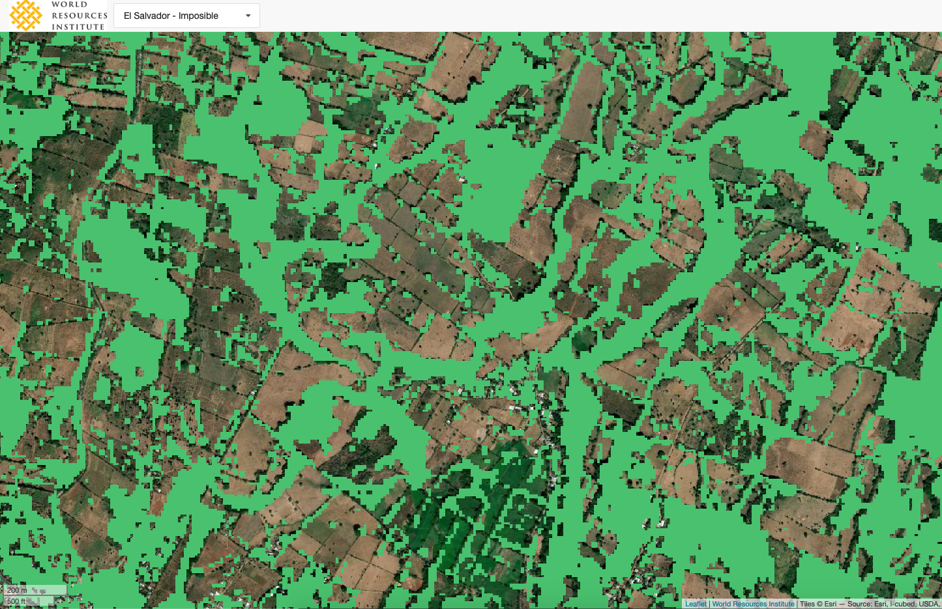
EL SALVADOR

Slide 19
The maps look just as good for:
Brazil
Cameroon
CAR
DRC
Ethiopia
Ghana
Guatemala
Guinea
India
Indonesia
Kenya
Madagascar
Malawi
Mexico
Nicaragua
Niger
El Salvador
Tanzania
Working on improvements in:
Rwanda
Colombia

Slide 20
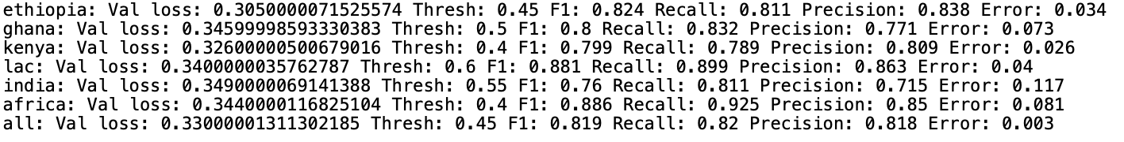
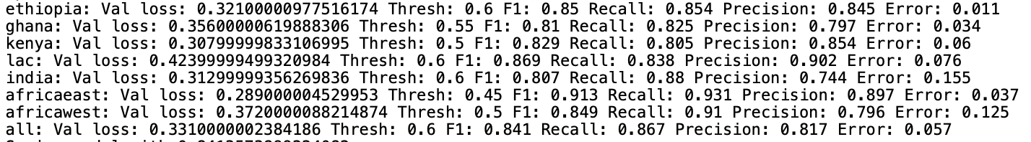
Sentinel-2 – 100 epochs, 50 hours
Sentinel-1 + 2 – 8 epochs, 4 hours
A 2.2% increase in accuracy is a 14% reduction in the error frequency

Slide 21
